Slide 1

COMPREHENSIVE SEMINAR
Presented by:
Mr. Dukhishyam Sabat
Ph.D Scholar
Scholar No: 20-3-04-101
Under the guidance of:
Dr. Prabina Pattanayak
and
Dr. Ganesh prasad
Department Of Electronics And Communication Engineering
NATIONAL INSTITUTE OF TECHNOLOGY, SILCHAR

Slide 2

Doctoral Committee (DC)
Prof. R.H.Laskar, Chairman of DC
Dr. P. Pattanayak, Supervisor and Member of DC
Dr. Ganesh Prasad, Co-Supervisor, Member of DC
Dr. Wasim Arif, Member of DC
Dr. R. Hazra , Member of DC ( Nominee of Chairman)

Slide 3

Outline
Course Work Details
  Research Methodology
  Information Theory And Coding
  Communication system Theory
Broad Area of Research
Relevance of Course Work with Area of Research
Conclusions
National institute of technology Silchar

Slide 4
Course work details
Sl. No. | Subject code | Subject | Faculty | Credit | Grades obtained
1. | IC001 | Research Methodology | Prof. M.A. Ahmed, Prof. G. Das, Prof. A. Roy, Prof. B.K. Roy, and Prof. N. Sinha | 06 | AB
2. | EC-538 | Information Theory And Coding | Dr. P Pattanayak | 06 | AA
3. | EC-537 | Communication system theory | Dr. D.S.Gurjar | 06 | AA
Cumulative Performance Index (CPI) = 9.6

Slide 5
IC-001
RESEARCH METHODOLOGY

Slide 6
Contents
RESEARCH METHODOLOGY
What is research?
Methodology
Various stages of Research
Objectives of Research
Writing Technical Papers
Types of research
Thesis Writing
Research Skills
Good research
Course Outcomes

Slide 7




Research[1]
Research is a systematic process of collecting and analyzing information to increase our understanding of the phenomenon under study.
Research is a logical and systematic investigation for finding solution to scientific and social problems.
Research is search for knowledge, i.e. ,A discovery of hidden truth.
Research leads to new contribution to the existing knowledge.
Research is an examination of a subject from different points of view.
Research is to go back and search until we find – explore.
[1] R.Kumar,“Research methodology: A step-by-step guide for beginners,”Sage Publications Limited, 2019.

Slide 8

Methodology[1]
Methodology does not set out to provide solutions; it is therefore not same as the method.
Research methodology is a systematic way to solve a problem.
It is a science of studying how research is to be carried out.
Its aim is to give the work plan of research.
[1] R.Kumar,“Research methodology: A step-by-step guide for beginners,”Sage Publications Limited, 2019.

Slide 9
Objectives of Research[2]
To discover new facts.
To verify and test important facts.
To analyze an event or process or phenomenon to identify the cause and effect relationship.
To develop new scientific tools, concepts and theories to solve scientific and nonscientific problems.
To find solutions to scientific, nonscientific and social problems.
To overcome or solve the problems occurring in our every day life.
[2] E. M. Phillips, and D. S. Pugh,“How to get a Ph. D.-A Handbook for Ph. D. and Their Students,”McGraw-Hill Education, 4th ed., Maidenhead, England, 2005.

Slide 10
Types of Research[1]
Based on Purpose
Descriptive
Based on Method
Conceptual
Empirical
Analytical
Explanatory
Exploratory
Based on Approach to Inquiry
Based on Applications of Findings
Quantitative
Qualitative
Fundamental
Applied
[1] R.Kumar,“Research methodology: A step-by-step guide for beginners,”Sage Publications Limited, 2019.

Slide 11
Fundamental Research
Basic research is an investigation on basic principles and reasons for occurrence of a particular event or process or phenomenon.
Basic researches some times may not lead to immediate use or application. It is not concerned with solving any practical problems.
The outcomes of basic research form the basis for many applied research.
Applied Research
Applied research solves certain problems employing well known and accepted theories and principles.
The central aim of applied research is to find a solution for a practical problem which wants solution for immediate use.
Most of the experimental research, case studies are essentially applied research. For example, research on social problems such as research on pollution control, etc.

Slide 12
Quantitative Research
Quantitative research is based on the measurement of quantity or amount
The result of this research is essentially a number or a set of numbers.
Quantitative research often begins with the collection of data based on a theory or hypothesis or experiment followed by the application of statistical methods.
It finds applications not only in physical sciences but also in economics, social sciences and biology.
Qualitative Research
Qualitative research is concerned with qualitative phenomenon involving quality.
Qualitative methods can be used to understand the meaning of the numbers obtained by quantitative methods.

Slide 13
Conceptual Research
Conceptual research is generally used by philosophers and thinkers to develop new concepts or to reinterpret existing ones.
Empirical Research
Empirical research is a data based research which depends on experience or observation alone.
Descriptive Research
Descriptive research includes surveys and fact-finding enquiries of different kinds. Most ex. post facto research projects are used for descriptive studies.
Analytical Research
Analytical research, the researcher has to use the already available facts or information, and analyse them to make a critical evaluation.

Slide 14
Good Research[3]
Quality of research publications
No. of citations of the publications
Project completed
Book published
Contribution made to the science and society
[3] A. Wilson,“Handbook of Science Communication,”Taylor Fransic, 1st ed., Abingdon, UK, 1998.

Slide 15
Various Stages of Research[3]
Selection of Research topic
Definition of a research problem
Literature survey
Assessment of current status of the topic chosen
Formulation of hypotheses
Research Design
Actual Investigation
Data analysis
Report
Interpretation of result
[3] A. Wilson,“Handbook of Science Communication,”Taylor Fransic, 1st ed., Abingdon, UK, 1998.

Slide 16
Research Skills[3]
Thinking
Comprehension
Creative thinking
Problem-Finding
Literature Survey
Technical Communication
Oral
Written
Time & Stress Management
Experimentation
Hypothesis
Positive Attitude, Meditation, Accepting failure
Workout
[3] A. Wilson,“Handbook of Science Communication,”Taylor Fransic, 1st ed., Abingdon, UK, 1998.

Slide 17
Writing Technical Papers[1]
Title
Keywords
Acknowledgements
Author(s), Affiliation, Contact Info
Abstract
Methodology
Results & Discussion
Conclusions
References
Appendices
Brief Biography of Authors (optional)
[1] R.Kumar,“Research methodology: A step-by-step guide for beginners,”Sage Publications Limited, 2019.

Slide 18
Thesis Writing[1]
Title
Abstract
Table of Contents
List of Figures & Tables
Introduction
Background theory
Design/theoretical analysis
Procedure
Results and discussion
Conclusions
References
Appendices
Abbreviations List
[1] R.Kumar,“Research methodology: A step-by-step guide for beginners,”Sage Publications Limited, 2019.

Slide 19
Course Outcomes
Effective research procedure.
Qualitative and quantitative research analysis.
Framing of technical report and thesis
Conducive presentation skills.
Stress management and time management techniques to maintain a balance between social and professional life.
References
[1] R.Kumar,“Research methodology: A step-by-step guide for beginners,”Sage Publications Limited, 2019.
[2] E. M. Phillips, and D. S. Pugh,“How to get a Ph. D.-A Handbook for Ph. D. and Their Students,”McGraw-Hill Education, 4th ed., Maidenhead, England, 2005.
[3] A. Wilson,“Handbook of Science Communication,”,Taylor Fransic, 1st ed., Abingdon, UK, 1998.

Slide 20
EC-538
Information Theory And Coding

Slide 21
Contents
Information, Entropy, Mutual Information
Data Compression
Kraft Inequality
Shannon Coding Theorem
Channel Capacity of Different Channels
Motivation

Slide 22
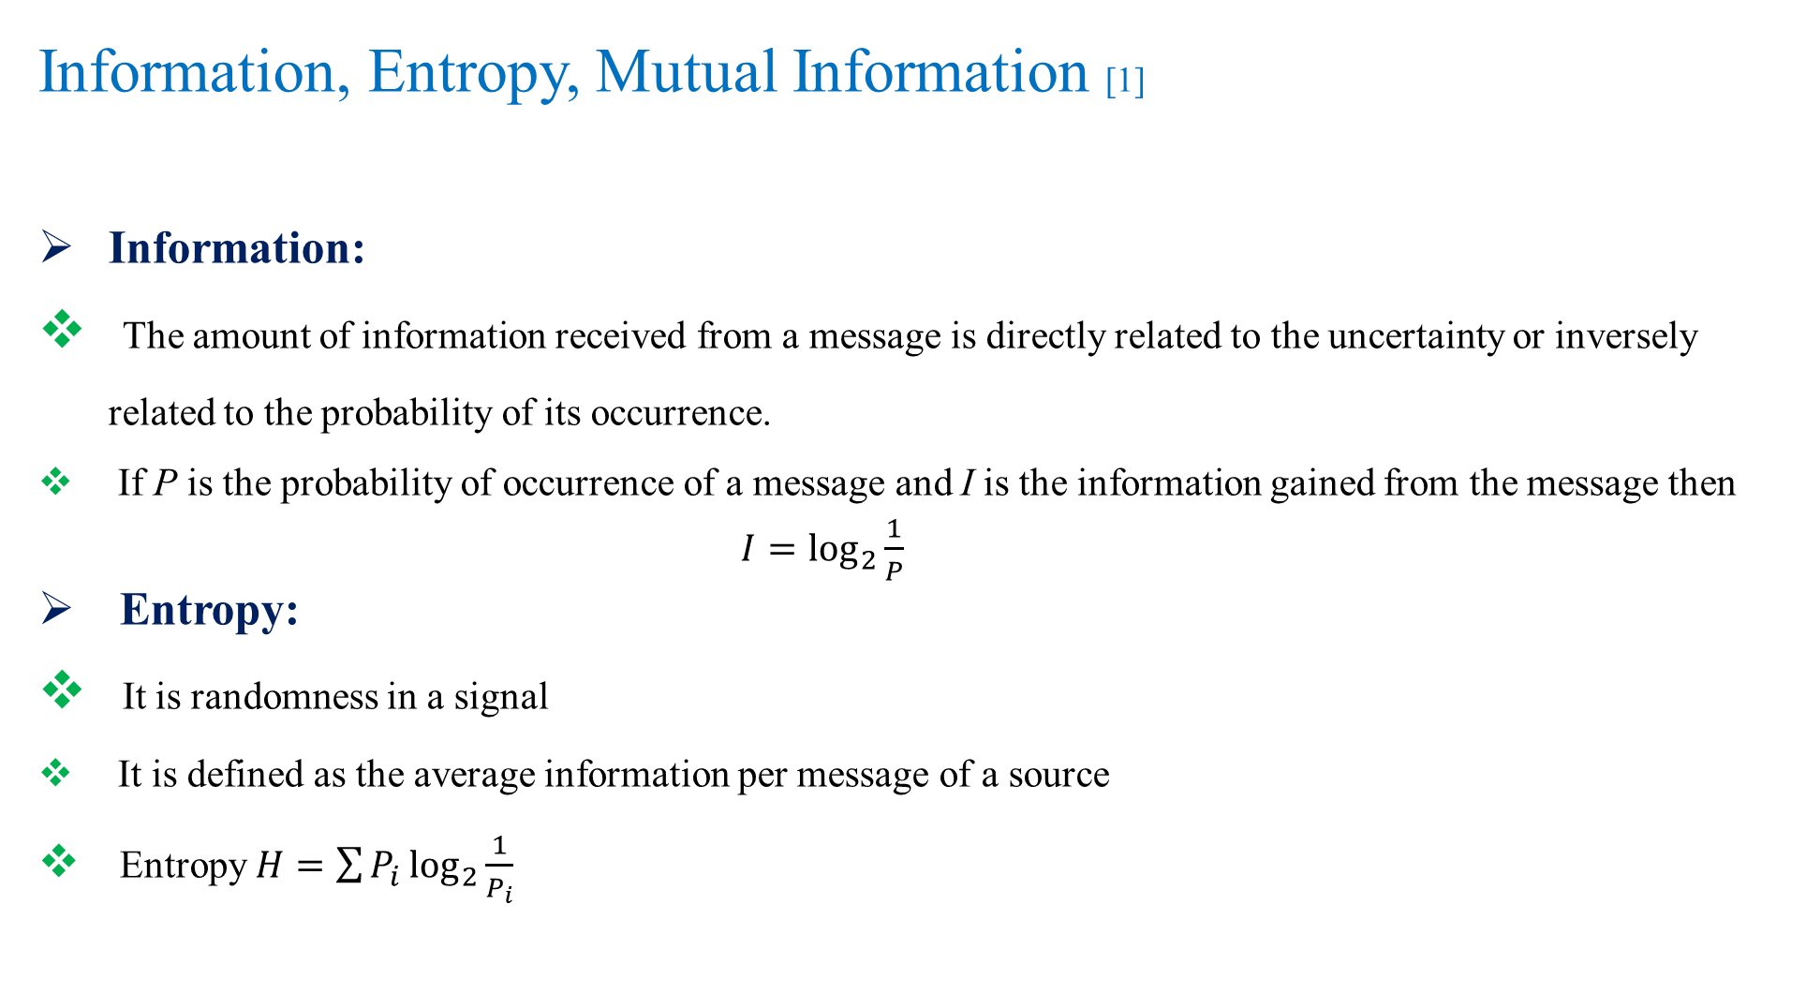
Information, Entropy, Mutual Information [1]
Information:
The amount of information received from a message is directly related to the uncertainty or inversely related to the probability of its occurrence.
If P is the probability of occurrence of a message and Iis the information gained from the message then
$$I=\log_{2}{\frac{1}{P}}$$
Entropy:
It is randomness in a signal
It is defined as the average information per message of a source
Entropy $H=\sum{P_{i}\log_{2}{\frac{1}{P_{i}}}}$
[1] T. M Cover,J. A. Thomas,“Elements of information theory”, John Wiley & Sons, Inc Publication, Second Edition 2006

Slide 23
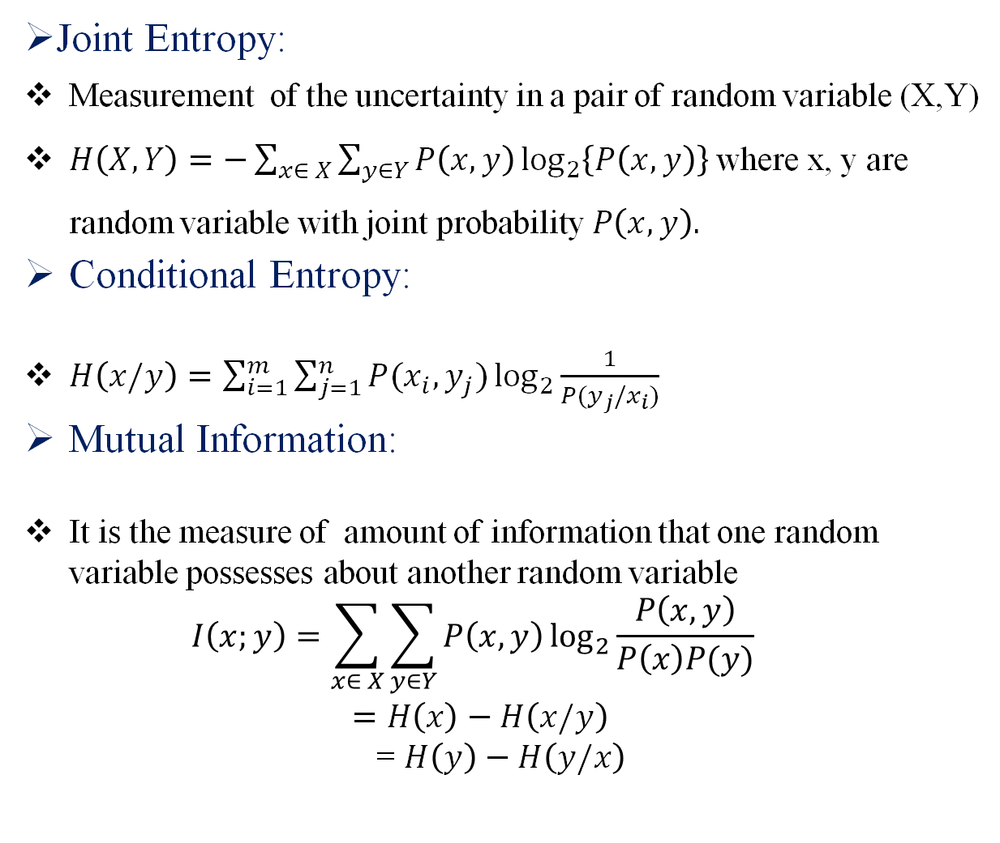
Information, Entropy, Mutual Information cont..[1]
Joint Entropy:
Measurement of the uncertainty in a pair of random variable (X,Y)
$H\left(X,Y\right)=−\sum_{x∈ X}{\sum_{y∈Y}{P\left(x,y\right)\log_{2}\left\{P\left(x,y\right)\right\}}}$where x, y are random variable with joint probability $P\left(x,y\right).$
Conditional Entropy:
$H\left(x/y\right)=\sum_{i=1}^{m}{\sum_{j=1}^{n}{P(x_{i},y_{j})\log_{2}{\frac{1}{P(y_{j}/x_{i})}} }}$
Mutual Information:
It is the measure of amount of information that one random variable possesses about another random variable
  $$I\left(x;y\right)=\sum_{x∈ X}{\sum_{y∈Y}{P\left(x,y\right)\log_{2}{\frac{P\left(x,y\right)}{P\left(x\right)P(y)}}}}$$
  $$=H\left(x\right)−H\left(x/y\right)$$
  = $H\left(y\right)−H\left(y/x\right)$

Slide 24
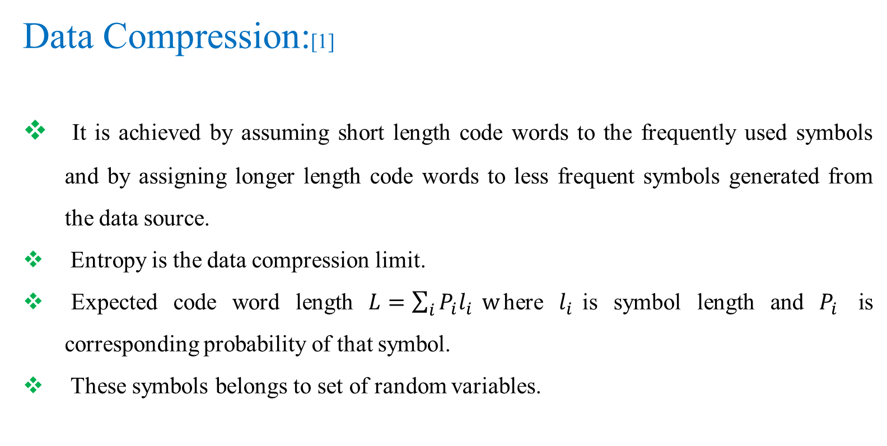
Data Compression:[1]
It is achieved by assuming short length code words to the frequently used symbols and by assigning longer length code words to less frequent symbols generated from the data source.
Entropy is the data compression limit.
Expected code word length $L=\sum_{i}{P_{i}l_{i}} w$here $l_{i}$is symbol length and $P_{i}$ is corresponding probability of that symbol.
These symbols belongs to set of random variables.
[1] T. M Cover,J. A. Thomas,“Elements of information theory”, John Wiley & Sons, Inc Publication, Second Edition 2006

Slide 25
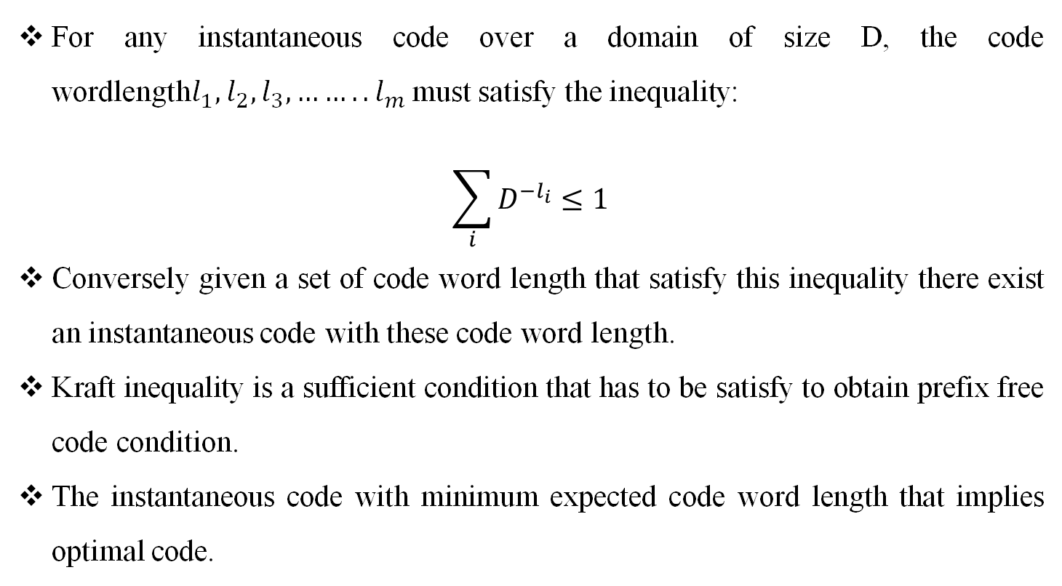
Kraft Inequality:[2]
For any instantaneous code over a domain of size D, the code wordlength$l_{1},l_{2},l_{3},……..l_{m}$ must satisfy the inequality:
$$\sum_{i}{D^{−l_{i}}≤1}$$
Conversely given a set of code word length that satisfy this inequality there exist an instantaneous code with these code word length.
Kraft inequality is a sufficient condition that has to be satisfy to obtain prefix free code condition.
The instantaneous code with minimum expected code word length that implies optimal code.
[2] F. M. Reza,“An introduction to information theory”, Dover publication, Inc. New York Second Edition 1961

Slide 26
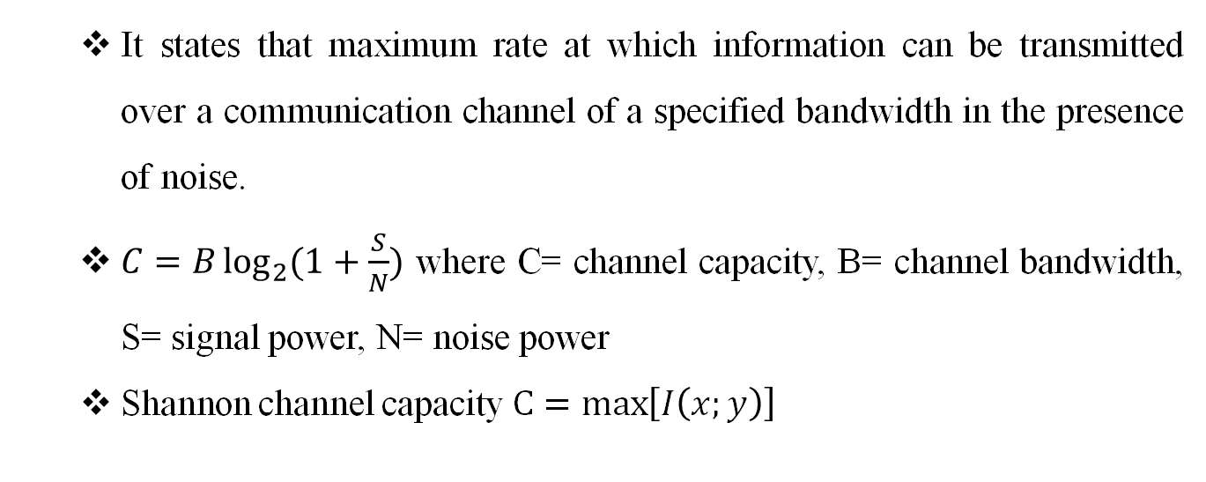
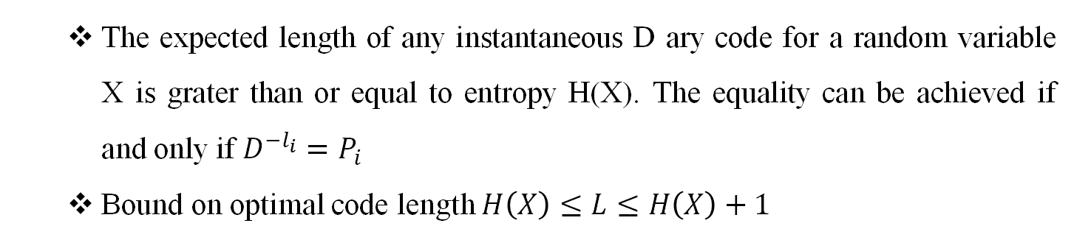
Shannon’s Coding Theorem[3]
Shannon’s Source Coding theorem:
  The expected length of any instantaneous D ary code for a random variable X is grater than or equal to entropy H(X). The equality can be achieved if and only if $D^{−l_{i}}=P_{i}$
  Bound on optimal code length $H\left(X\right)≤L≤H\left(X\right)+1$
Shannon’s Channel Coding theorem:
  It states that maximum rate at which information can be transmitted over a communication channel of a specified bandwidth in the presence of noise.
  $C=B\log_{2}{(1+\frac{S}{N})}$ where C= channel capacity, B= channel bandwidth, S= signal power, N= noise power
  Shannon channel capacity $C=\max\left[I\left(x;y\right)\right]$

Slide 27
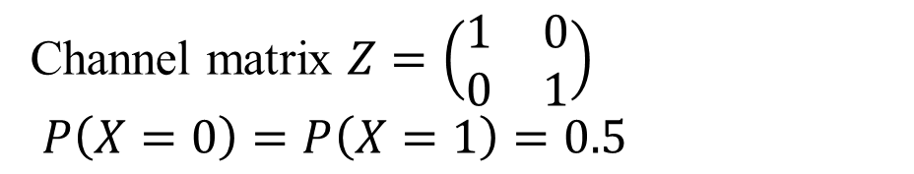
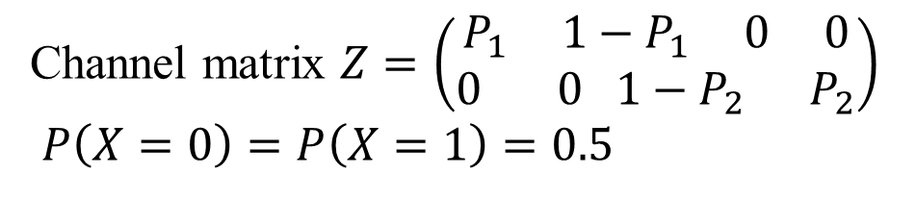


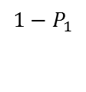
Channel Capacity of Different Channels[3]
Noiseless Binary Channel:
Noisy Channel with Non Overlapping Outputs:
X
Y
Channel matrix $Z=\left(\begin{matrix}1 & 0 \\ 0 & 1\end{matrix}\right)$
$$P\left(X=0\right)=P\left(X=1\right)=0.5$$
0
0
1
1
Fig. 1. Noiseless binary channel
X
Y
$$P_{1}$$
0
$${1−P}_{1}$$
Channel matrix $Z=\left(\begin{aligned}P_{1} 1−P_{1} 0 0 \\ 0 0 1−P_{2} P_{2}\end{aligned}\right)$
$$P\left(X=0\right)=P\left(X=1\right)=0.5$$
1
$$P_{2}$$
Fig. 2. Channel with overlapping outputs
[3] R. Bose, “ Information Theory, Coding and Cryptography ”,Tata Mcgraw Hill Publication, Second Edition 2008.

Slide 28
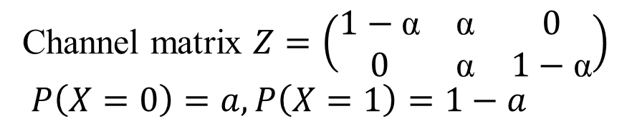
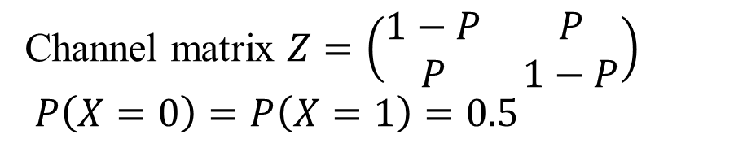
Channel Capacity of Different Channels cont.[3]
Binary Symmetric Channel:
Binary Erasure Channel:
X
y
Channel matrix $Z=\left(\begin{matrix}1−P & P \\ P & 1−P\end{matrix}\right)$
$$P\left(X=0\right)=P\left(X=1\right)=0.5$$
1-P
0
0
P
P
1
1
1-P
Fig. 3. Binary Symmetric channel
X
1-α
y
0
0
α
e
Channel matrix $Z=\left(\begin{matrix}1−\text{α} & \text{α} & 0 \\ 0 & \text{α} & 1−\text{α}\end{matrix}\right)$
$$P\left(X=0\right)=a, P\left(X=1\right)=1−a$$
α
1
1
1- α
Fig. 4. Binary Erasure channel
[3] R. Bose, “ Information Theory, Coding and Cryptography ”,Tata Mcgraw Hill Publication, Second Edition 2008.

Slide 29
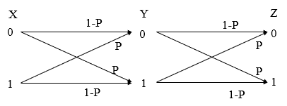
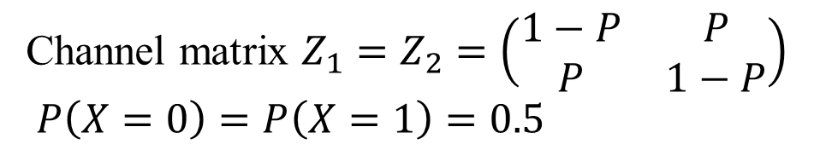
Channel Capacity of Different Channels cont. [3]
Cascading of binary symmetric channel:
Channel matrix $Z_{1}=Z_{2}=\left(\begin{matrix}1−P & P \\ P & 1−P\end{matrix}\right)$
$$P\left(X=0\right)=P\left(X=1\right)=0.5$$
Fig. 5. Cascading of binary channel
[3] R. Bose, “ Information Theory, Coding and Cryptography ”,Tata Mcgraw Hill Publication, Second Edition 2008.

Slide 30
Course Outcomes
Measuring information content of a message
Different source coding techniques for efficient transmission
Importance of channel capacity
Channel coding techniques to increase reliability of a system
Reference
[1] T. M Cover,J. A. Thomas,“Elements of information theory”, John Wiley & Sons, Inc Publication, Second Edition 2006.
[2] F. M. Reza,“An introduction to information theory”, Dover publication, Inc. New York Second Edition 1961.
[3] R. Bose, “ Information Theory, Coding and Cryptography ”,Tata Mcgraw Hill Publication, Second Edition 2008.

Slide 31
Communication System Theory
(EC- 537)

Slide 32
Contents
Elements of a digital communication system
Error function and Q function
Detection error of different encoding scheme
Matched filter
Digital modulation techniques
Probability error for different modulation schemes
Non coherent detection
Synchronization method
Signal distortion over communication channel

Slide 33
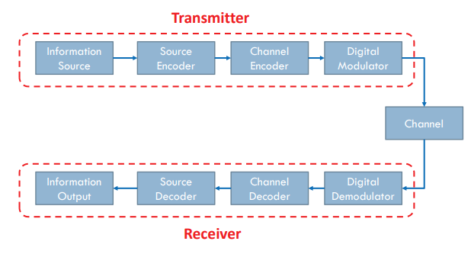
Elements of a Digital Communication System [1]
Fig. 6. Basic Elements of a Digital Communication System
[1] John G. Proakis and M. Salehi, Digital Communications, 5th Edition, McGraw-Hill, New York, 2007.

Slide 34
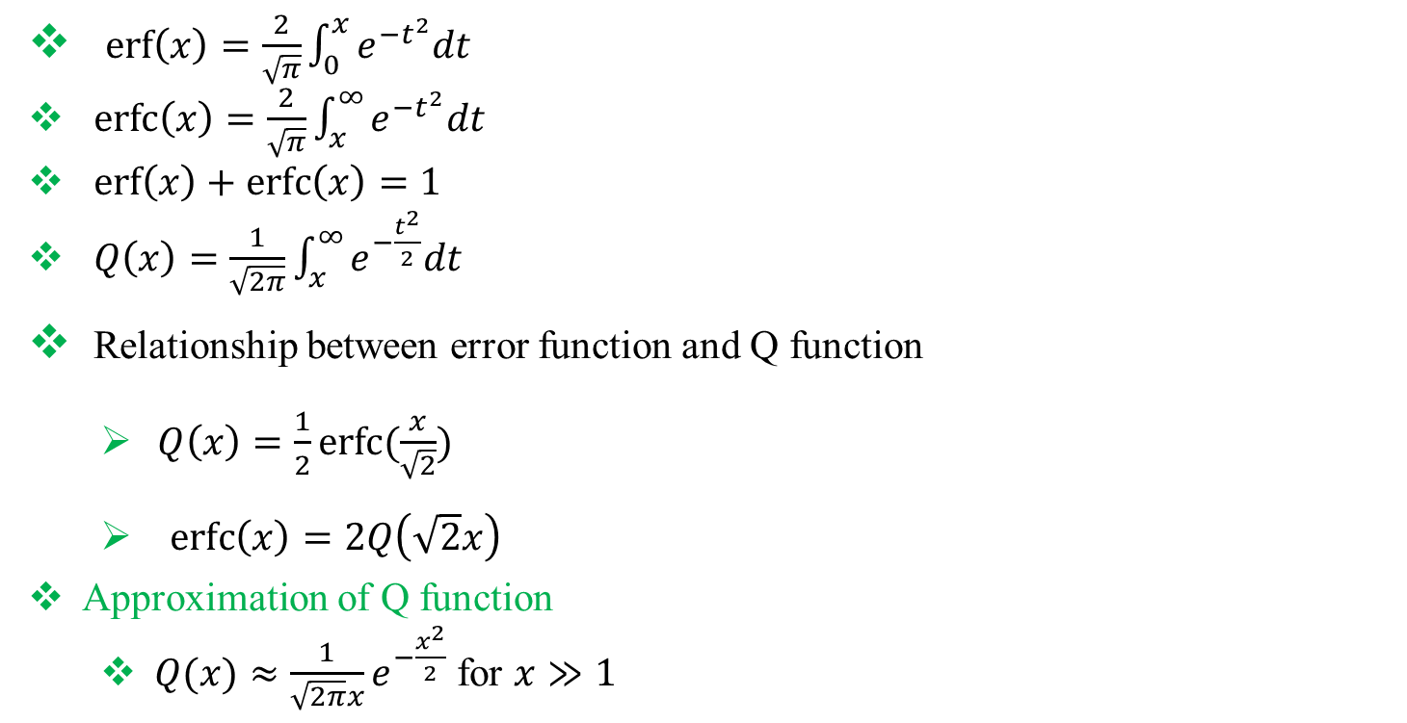
Error Function and Q function [2]
$\operatorname{erf}\left(x\right)=\frac{2}{\sqrt{π}}\int_{0}^{x}{e^{−t^{2}}dt}$
$\operatorname{erfc}\left(x\right)=\frac{2}{\sqrt{π}}\int_{x}^{∞}{e^{−t^{2}}dt}$
$\operatorname{erf}\left(x\right)+\operatorname{erfc}\left(x\right)=1$
$Q\left(x\right)=\frac{1}{\sqrt{2π}}\int_{x}^{∞}{e^{−\frac{t^{2}}{2}}dt}$
Relationship between error function and Q function
  $Q\left(x\right)=\frac{1}{2}erfc⁡(\frac{x}{\sqrt{2}})$
  $\operatorname{erfc}\left(x\right)=2Q\left(\sqrt{2}x\right)$
Approximation of Q function
  $Q(x)≈\frac{1}{\sqrt{2π}x}e^{−\frac{x^{2}}{2}}$ for $x≫1$
[2] B. P. Lathi ," Morden Digital and Analaog Communication System ", 4th Edition, Oxford University Press, 2010.

Slide 35
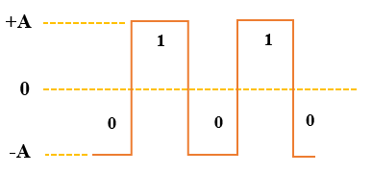
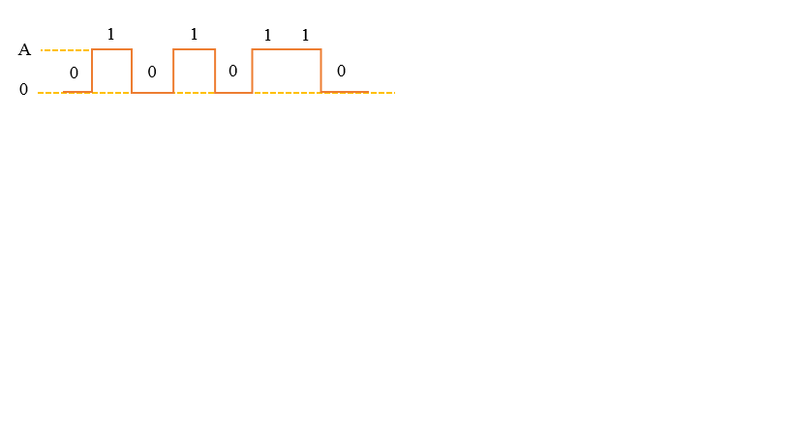
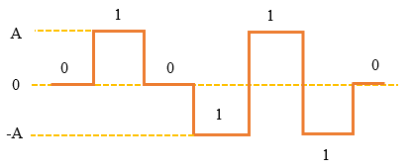
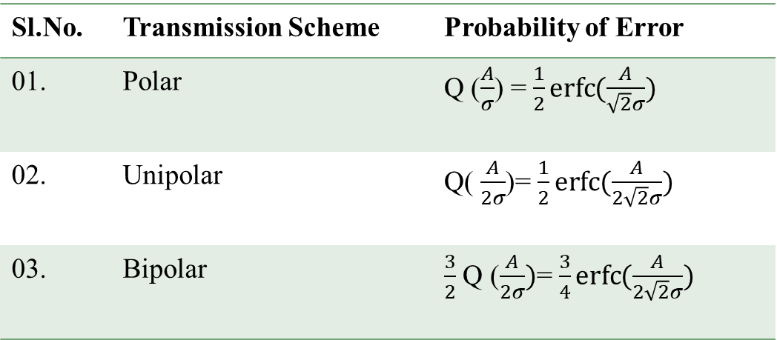
Detection Error of Different Encoding Schemes[2]
Polar Transmission
Unipolar Transmission
Fig. 8. Unipolar Signal
Fig. 7. Polar Signal
Table 1: Probability of error of various transmission schemes
Bipolar Transmission
Sl.No. | Transmission Scheme | Probability of Error
01. | Polar
02. | Unipolar
03. | Bipolar
Fig. 9. Bipolar Signal

Slide 36


Matched Filter [2]
The matched filter is the optimal linear filter for maximizing the signal to noise ratio (SNR) in the presence of additive White Gaussian noise.
A matched filter is obtained by correlation of received signal with p(t). Similarity measures the sign of the correlation and decide whether +p(t) or –p(t) was transmitted
Impulse response of matched filter $h\left(t\right)=kp(T−t)$ where T= pulse duration,
k= system gain
Σ
Matched
Filter
y
Decision
Device
m =1 if y>λ
Signal
S(t)
Sampled at time t=$T_{b}$
m =0 if y<λ
Threshold
λ
AWGN
N(t)
Fig. 10. Block diagram of matched filter
[2] B. P. Lathi ," Morden Digital and Analaog Communication System ", 4th Edition, Oxford University Press, 2010.

Slide 37
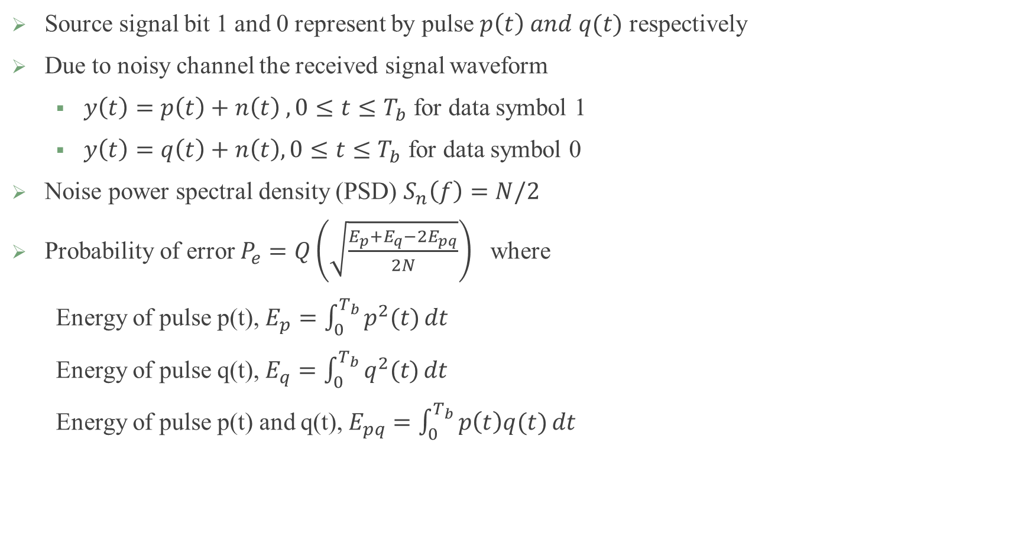
Matched Filter cont. [2]
Source signal bit 1 and 0 represent by pulse $p\left(t\right) and q(t)$ respectively
Due to noisy channel the received signal waveform
  $y\left(t\right)=p\left(t\right)+n\left(t\right) ,0≤t≤T_{b}$ for data symbol 1
  $y\left(t\right)=q\left(t\right)+n\left(t\right), 0≤t≤T_{b}$ for data symbol 0
Noise power spectral density (PSD) $S_{n}\left(f\right)=N/2$
Probability of error $P_{e}=Q\left(\sqrt{\frac{E_{p}+E_{q}−2E_{pq}}{2N}}\right)$ where
Energy of pulse p(t), $E_{p}=\int_{0}^{T_{b}}{p^{2}(t)}dt$
Energy of pulse q(t), $E_{q}=\int_{0}^{T_{b}}{q^{2}(t)}dt$
Energy of pulse p(t) and q(t), $E_{pq}=\int_{0}^{T_{b}}{p\left(t\right)q(t)}dt$
[2] B. P. Lathi ," Morden Digital and Analaog Communication System ", 4th Edition, Oxford University Press, 2010.

Slide 38
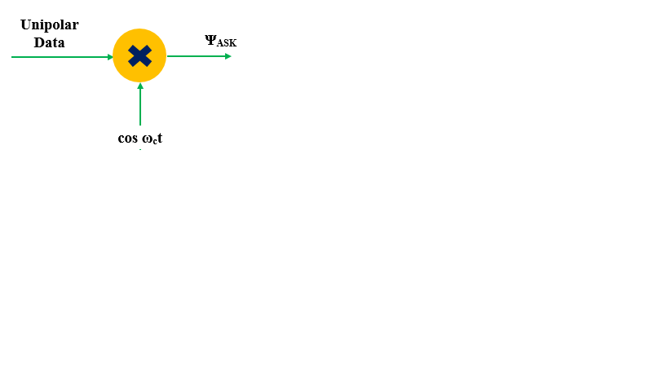
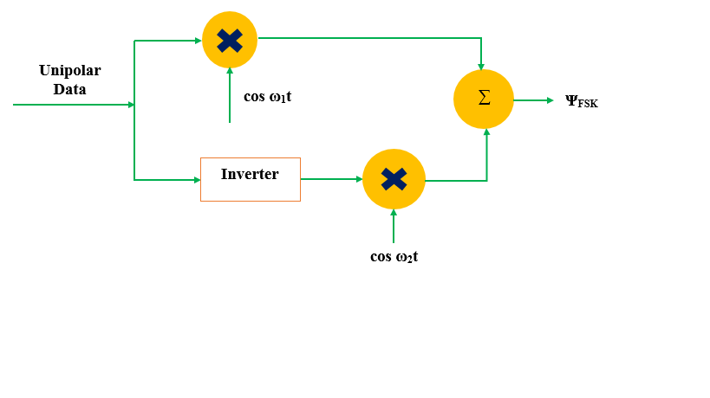
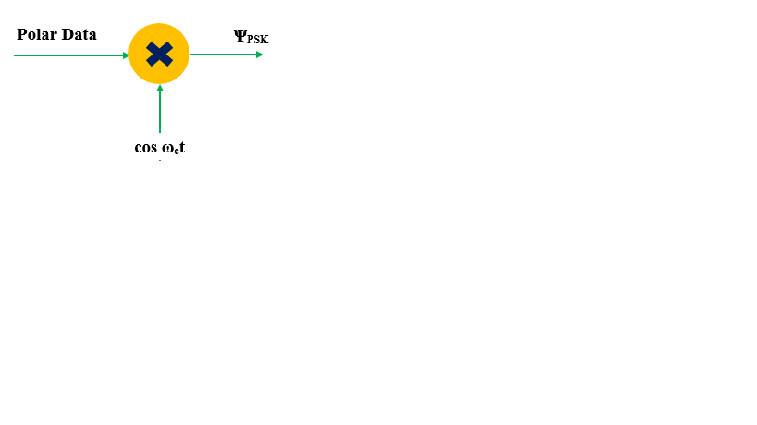
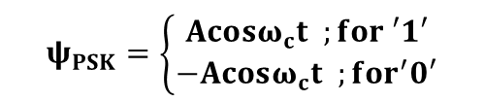
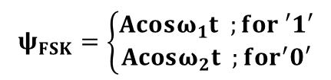

Digital Modulation Techniques [2]
Generation:
ASK
PSK
FSK
$$ψ_{ASK}=\left\{\begin{aligned}Acosω_{c}t ;for ′1′ \\ 0 ;for^{′}0′\end{aligned}\right.$$
$$ψ_{FSK}=\left\{\begin{aligned}Acosω_{1}t ;for ′1′ \\ Acosω_{2}t ;for^{′}0′\end{aligned}\right.$$
(a)
(c)
$$ψ_{PSK}=\left\{\begin{aligned}Acosω_{c}t ;for ′1′ \\ −Acosω_{c}t ;for^{′}0′\end{aligned}\right.$$
Fig. 11. (a) ASK Generation (b) PSK Generation (c) FSK Generation
(b)

Slide 39
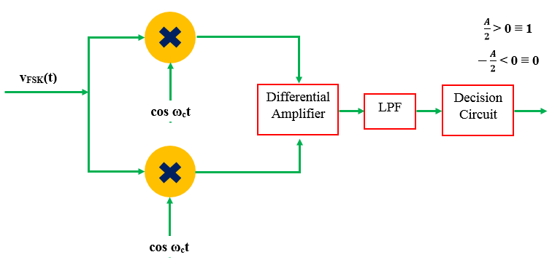
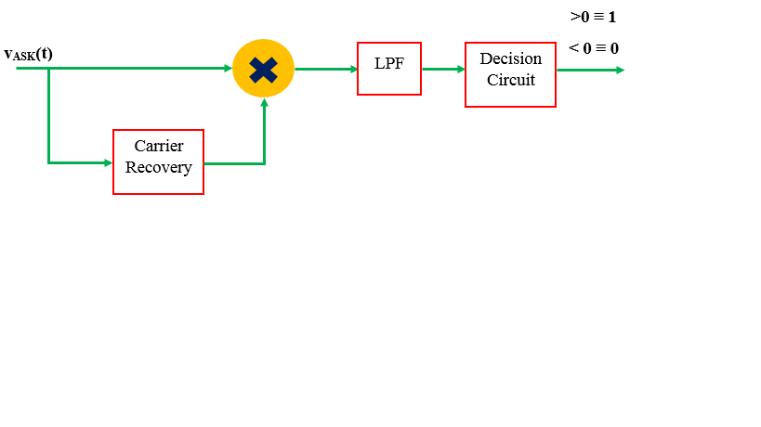


Detection:
FSK Detection (Coherent)
ASK Detection (Coherent):
$$\cos{ω_{1}t}$$
$$\cos{ω_{2}t}$$
(b)
(a)
Fig. 12. (a) Coherent Detection of ASK (b) Coherent Detection of FSK

Slide 40
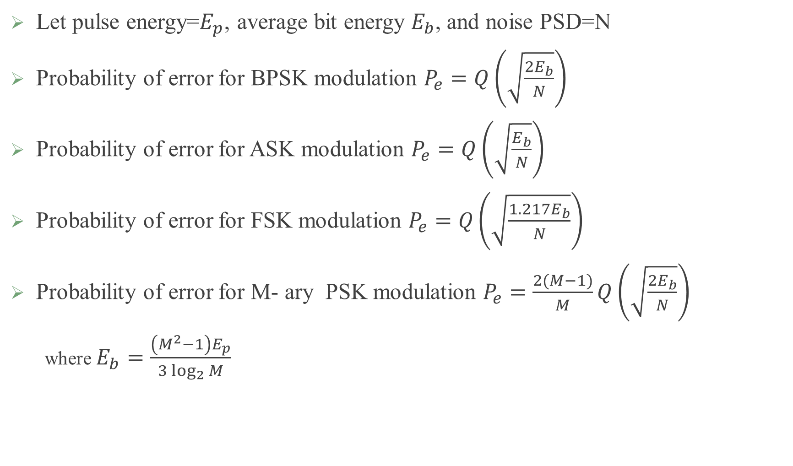
Probability Error for Different Modulation Schemes [2]
Let pulse energy=$E_{p}$, average bit energy $E_{b}$, and noise PSD=N
Probability of error for BPSK modulation $P_{e}=Q\left(\sqrt{\frac{2E_{b}}{N}}\right)$
Probability of error for ASK modulation $P_{e}=Q\left(\sqrt{\frac{E_{b}}{N}}\right)$
Probability of error for FSK modulation $P_{e}=Q\left(\sqrt{\frac{{1.217E}_{b}}{N}}\right)$
Probability of error for M- ary PSK modulation $P_{e}=\frac{2(M−1)}{M}Q\left(\sqrt{\frac{2E_{b}}{N}}\right)$
  where $E_{b}=\frac{\left(M^{2}−1\right)E_{p}}{3\log_{2}{M}}$

Slide 41



Synchronization Method[2]
Phase lock loop (PLL)
PLL can track the incoming frequency only over a finite range of frequencies that range is called lock range
Initially the input and output frequencies are not close enough, the loop may not acquired lock
The frequency range over which the input will cause the loop to lock is called capture range
Lock range > capture range
$$A\sin\left(ω_{0}t+θ_{i}\right)$$
LPF
H(S)
Error signal $e_{0}(t)$
VCO
$$B\cos\left(ω_{0}t+θ_{o}\right)$$
Fig. 13. Block diagram of costas loop

Slide 42

SISO (Single Input Single Output)[3]
x1
y1 = h1x1
fading h1
transmit
receive
[3] E. Biglieri, R. Calderbank, A. Constantinides, A. Goldsmith, A. Paulraj, and H. V. Poor, "MIMO Wireless Communications", Cambridge Univesity Press, 2003.

Slide 43
SIMO( Single Input Multiple Output)[3]
y2 = h2x1
fading h2
x1
fading h1
y1 = h1x1
transmit
receive
[3] E. Biglieri, R. Calderbank, A. Constantinides, A. Goldsmith, A. Paulraj, and H. V. Poor, "MIMO Wireless Communications", Cambridge Univesity Press, 2003.

Slide 44
MISO (Multiple Input Single Output )[3]
Time 1 Time 2
x2
-x1*
fading h2
Time 1 Time 2
y1 = h1x1+ h2x2
x1
x2*
y2 = h1x2*+ h2-x1*
fading h1
transmit
receive

Slide 45
MIMO (Multiple Input Multiple Output)[3]
x1
y1
fading h1
y1 = h1x1+ h2x2
fading h3
y2 = h3x1+ h4x2
Finally Assume there is some white Gaussian Noise, and we have a set of linear equations
y = Hx + w
All 2 degrees of freedom are being utilized in the MIMO case, giving us Spatial Multiplexing.
x2
y2
fading h2
fading h4
transmit
receive
[3] E. Biglieri, R. Calderbank, A. Constantinides, A. Goldsmith, A. Paulraj, and H. V. Poor, "MIMO Wireless Communications", Cambridge Univesity Press, 2003.

Slide 46
Course Outcomes
Introduction about error function and Q function and interrelationship between them
Error occur due to noise during signal detection
Bit error rate for different modulation scheme
Signal detection method
Multiple antenna system
References
[1] John G. Proakis and M. Salehi, Digital Communications, 5th Edition, McGraw-Hill, New York, 2007.
[2] B. P. Lathi ," Morden Digital and Analaog Communication System ", 4th Edition, Oxford University Press, 2010.
[3] E. Biglieri, R. Calderbank, A. Constantinides, A. Goldsmith, A. Paulraj, and H. V. Poor, "MIMO Wireless Communications", Cambridge Univesity Press, 2003.

Slide 47
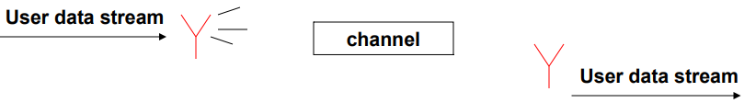
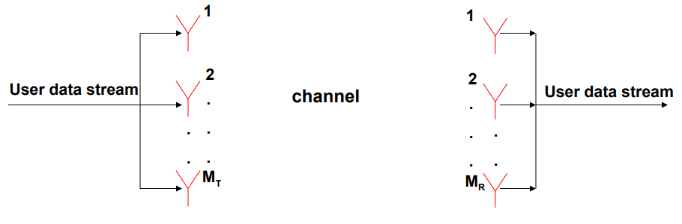
Antenna Configurations
Single-Input-Single-Output (SISO) antenna system
Use multiple transmit and multiple receive antennas.
This system promises enormous data rates

Slide 48
MIMO channel Model
h₁₁
h₁₂
User data stream
.
.
User data stream
.
.
.
.
Channel Matrix H
S
TRANSMITTED VECTOR
y
RECEIVED
VECTOR
H =

Slide 49
Channel state information (CSI)
CSI refers to known information used for channel estimation.
Type:
Channel state information at transmitter (CSIT)
Channel state information at receiver (CSIR)
Indirect methods for CSIT :
Based on the channel reciprocity principle.
By using feedback from the receiver.

Slide 50
Spatial Diversity Gain
  Signal copies are transferred from multiple antennas or received at more than one antenna.
By sending the same information through different paths, multiple independently-faded replicas of the data symbol can be obtained at the receiver end. Hence, more reliable reception is achieved.
Probability of error
signal to noise ratio for a SISO system. (Reciprocal of SNR)
d is the total number of independent signal paths.
Transmit Antennas
abc
abc
abc
Spatial Diversity
abc

Slide 51
Spatial Multiplexing
Each spatial channel carries independent information, there by increasing the data rate of the system.
Transmit Antennas
c
abc
Spatial Multiplexing
b
a

Slide 52
Zero–Forcing (ZF) Receiver
Received Signal
Estimated signal
Where, is a pseudo–inverse.
Significantly reduced receiver complexity.
Noise enhancement problem.

Slide 53
Minimum mean–square error (MMSE) Receiver
Received Signal
Estimated signal
Minimizes the overall error due to noise and mutual interference.
Equivalent to the zero–forcing receiver at high SNR.
Simplifies to matched filter receiver at low SNR.

Slide 54
Research Methodology gives an insight to the various aspects related to research which will be helpful to carry out my research work in coming days.
Information theory and coding gives an idea of statistical information, uncertainty and randomness of signal by which we can estimate the information of a signal in communication channel.
The concepts of Advanced Digital Communication will be helpful in designing the block diagram of various components and their operation for efficient communication in wireless sensor network.
Relevance to My Research Work

Slide 55
CONCLUSION
Coursework is a primary and essential stage before starting the research work
Coursework provides sufficient theoretical background for beginning the research work.
Researchers need to choose the relevant courses very carefully catering to the need for pursuing research in their area of interest.

Slide 56
THANK YOU

